Slide 1

Cloud-Based Food Surplus Prediction and
Hyperlocal Redistribution Network
SOA PROJECT REVIEW – 1
TEAM MEMBERS
2420030073 – Y. Bhavika
2420030038 – N. Keerthi Sri
2420030149 – Y. Adarsh Rishi
Under the Guidance of: P. Srilatha
Cloud-Native Application Development and Container Orchestration (24CND3101)

Slide 2
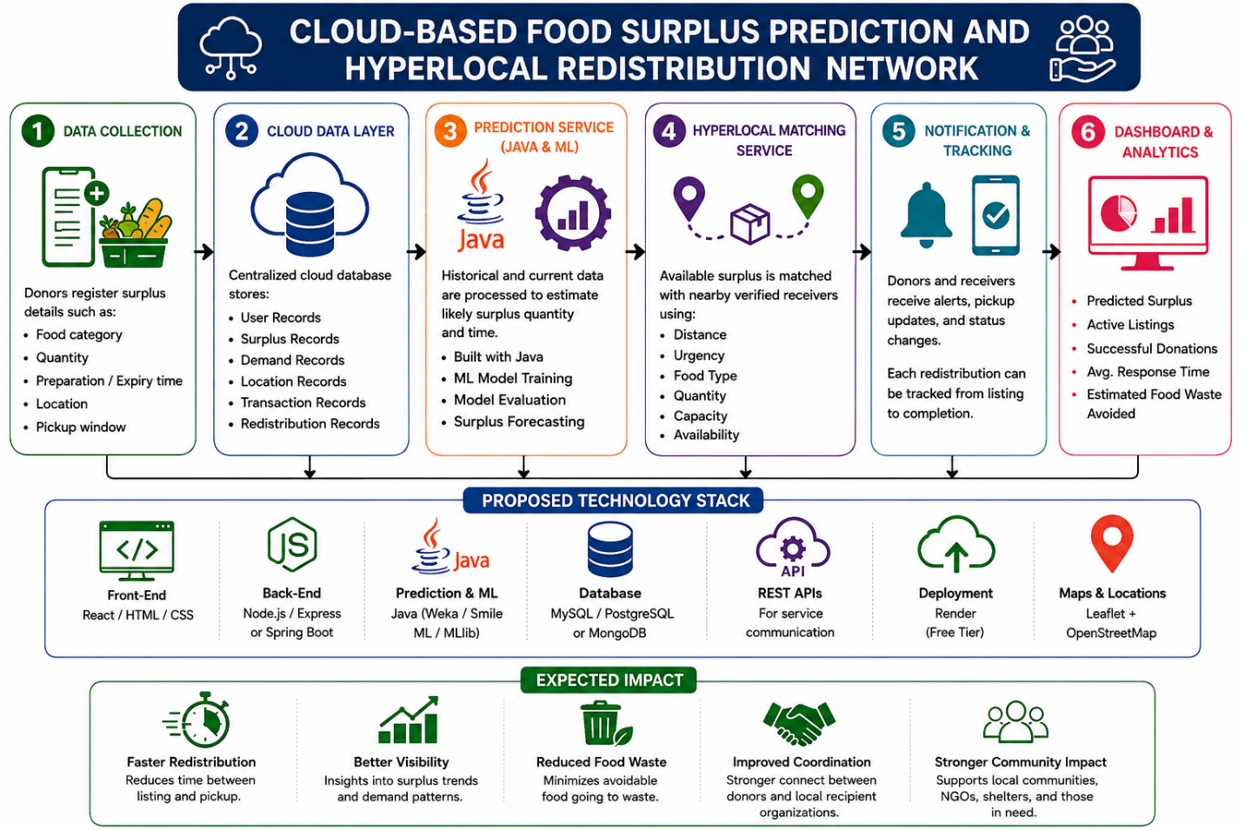
Outline of Project Work
Introduction and motivation
Problem statement
Research objectives
Literature survey / existing solution areas
Problem gap identification
Innovation, creativity, and novelty
Feasibility and project plan
Conclusion and future work
2

Slide 3
Problem Statement
Food surplus is generated daily by restaurants, supermarkets, hotels, cafeterias, events, and households.
Usable surplus is often identified too late or becomes difficult to redistribute before it becomes unusable.
Donors and nearby beneficiaries may not be connected quickly enough, causing avoidable food waste.
Existing processes may rely on manual coordination and may not predict where and when surplus will occur.
A cloud-based, location-aware system is needed to predict surplus and coordinate timely hyperlocal redistribution.
3

Slide 4
Research Objectives
Develop a cloud-based platform for registering and monitoring food surplus.
Use historical and real-time information to predict expected surplus quantity and timing.
Match available food with nearby verified NGOs, community kitchens, shelters, and food banks.
Consider geographic proximity, food type, quantity, urgency, receiver capacity, and pickup availability.
Provide notifications, pickup updates, and end-to-end redistribution tracking.
Provide dashboards for surplus trends, prediction results, active requests, successful redistributions, and impact metrics.
4

Slide 5
Literature Survey / Existing Solution Areas
Area
Existing Focus
Gap Relevant to This Project
Food surplus prediction
Uses historical/current data to estimate surplus quantity and timing.
Prediction needs to connect directly with redistribution.
Food donation platforms
Register available food and connect donors with recipients.
Limited emphasis on early surplus prediction and urgency.
Location-aware matching
Uses geographic proximity to identify nearby receivers.
Matching should also consider food type, quantity, capacity, and pickup availability.
Cloud-based coordination
Centralized data and scalable access for multiple users.
Needs integrated prediction, matching, notifications, and tracking services.
5

Slide 6
Problem Gap Identification
The project combines prediction, hyperlocal matching, notifications, and tracking in one workflow.
Early prediction can help identify expected surplus before it becomes an urgent waste problem.
Hyperlocal matching is not based only on distance; it also considers food type, quantity, urgency, receiver capacity, and pickup availability.
A service-oriented architecture separates user management, surplus registration, prediction, matching, notifications, and tracking into manageable services.
The cloud approach supports centralized data storage, scalable processing, real-time communication, and access for donors, volunteers, and recipient organizations.
6

Slide 7
Innovation, Creativity, and Novelty
Predict Before Waste
Forecast likely surplus quantity and timing using historical and real-time information.
Hyperlocal Intelligence
Match surplus with nearby verified receivers using multiple practical constraints.
Service-Oriented Design
Separate prediction, matching, notifications, tracking, and user services.
Real-Time Coordination
Provide alerts, pickup updates, and status changes across the redistribution process.
Impact Analytics
Track surplus trends, active requests, successful redistributions, and impact metrics.
7

Slide 8
Feasibility and Project Plan
Technical feasibility: React/HTML/CSS, Spring Boot/Java, Java-based ML, database services, REST APIs, Render deployment, and Leaflet + OpenStreetMap.
Operational feasibility: supports donors, volunteers, and recipient organizations through role-based services and tracking.
Scalability: cloud-based and service-oriented architecture can support centralized storage and scalable processing.
Expected outcome: faster redistribution, reduced avoidable food waste, improved transparency, and stronger coordination.
1. Requirements
Problem + users
2. Data
Collect & prepare data
3. Prediction
Java ML model
4. Services
Backend + APIs
5. UI & Matching
Map + redistribution
6. Testing
Integration + evaluation
7. Deployment
Render + final demo
8

